Slide 1

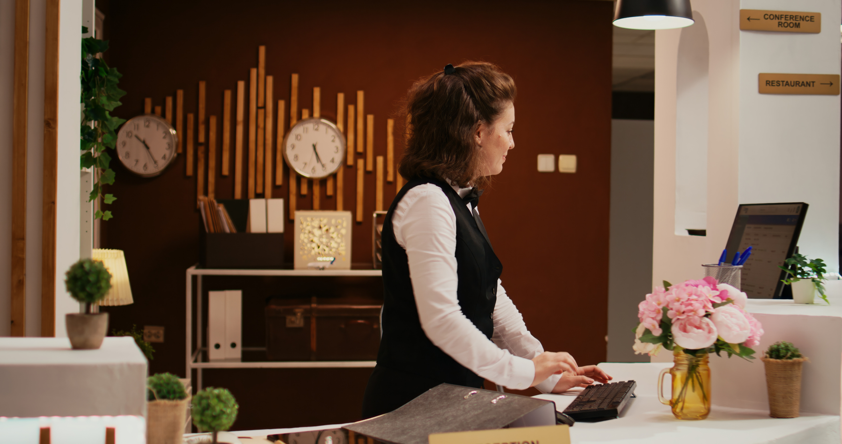
Factors affecting weather a customer is likely to cancel his booking

Slide 2
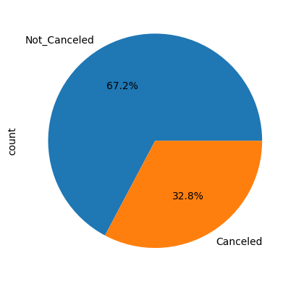
From the 36285 bookings done for this hotel almost third of them cancelled their booking

Slide 3
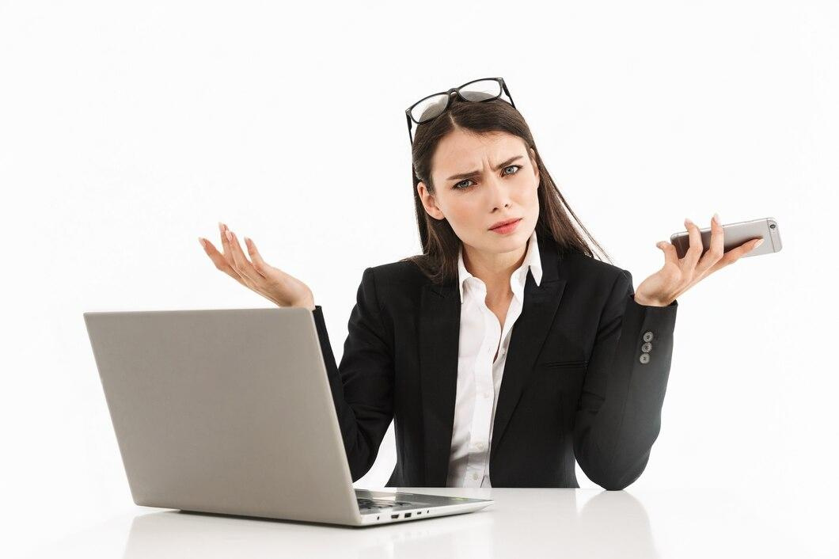
So how can we analyze the behavior of those who cancelled?

Slide 4

It turns out we don’t have enough data for each case for every feature so we will only consider the values which is frequent enough for us to make an interpretaion

Slide 5
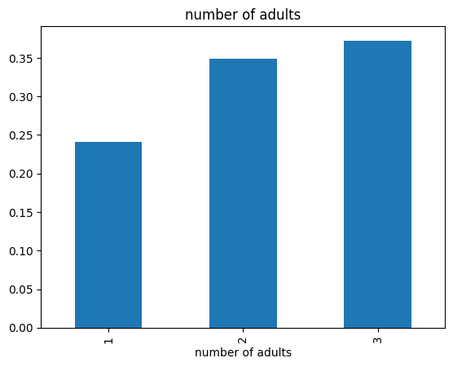
Probability of those who cancelled
It seems there is a slight positive
correlation with the number of adults

Slide 6
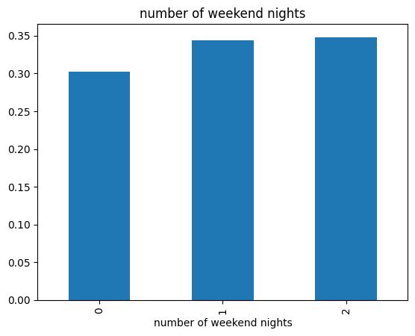
Probability of those who cancelled
For the number of weekend nights
there is no much of a correlation and this difference could be from random noise

Slide 7
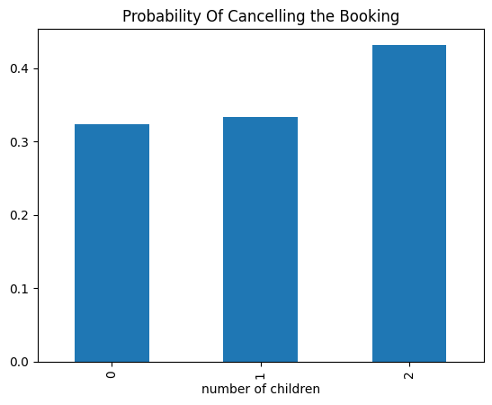
Same goes for the number of childs
weak positive correlation

Slide 8
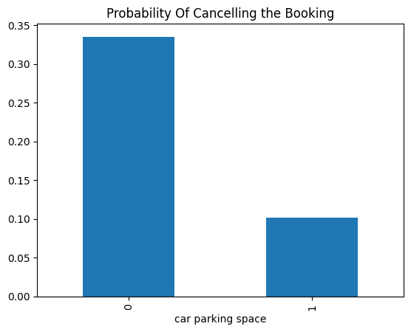
Here it gets more interesting, as when the customer asks for a parking space for his car that means he is serious about the booking

Slide 9
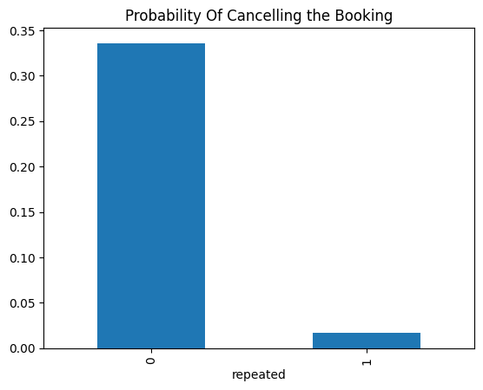
Also people who have previously booked in this hotel are very less likely to cancel

Slide 10
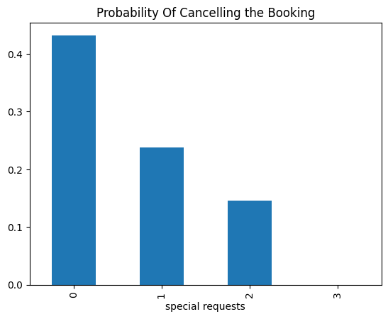
When the customer asks for some special requests while booking this indicates a more likelihood of not canceling

Slide 11
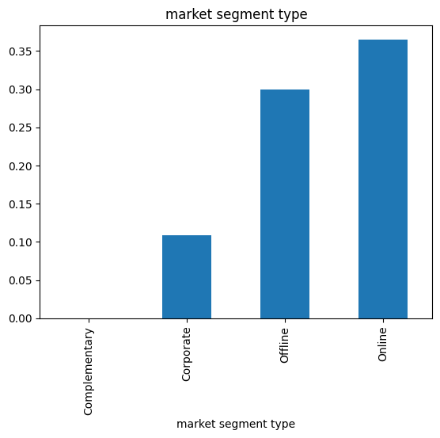
As expected people who book online are those who mostly cancel their booking unlike the others who
have put in the effort to book

Slide 12
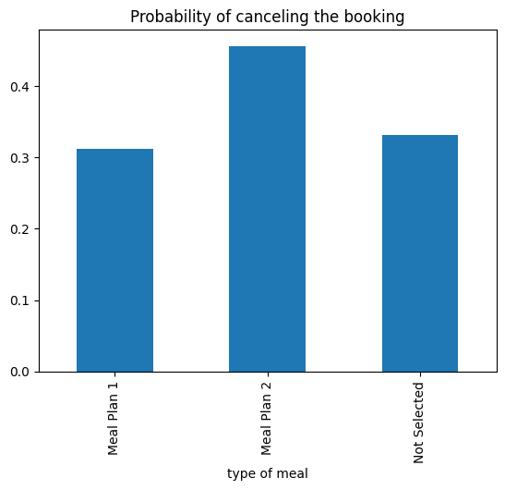
For some reason, meal plan 2 has the highest
probability of being cancelled

Slide 13
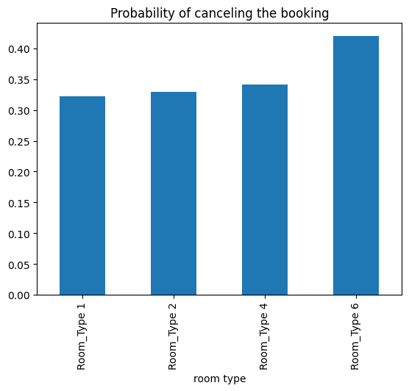
Not enough difference to say that the room type
affects weather they will cancel

Slide 14
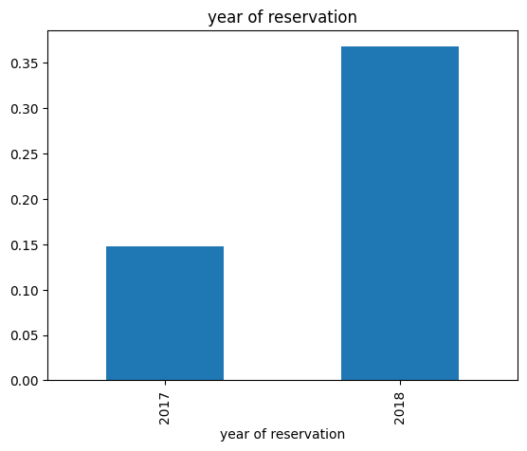
2018 by far had more cancellations than the previous year so we should investigate what happened in 2018

Slide 15
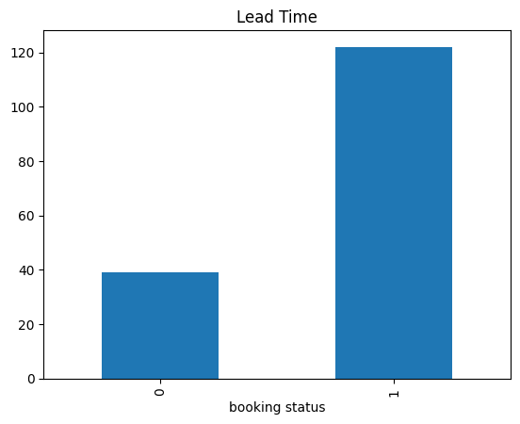
Also we should note that the longer the booking is pending the more likely it will be cancelled

Slide 16
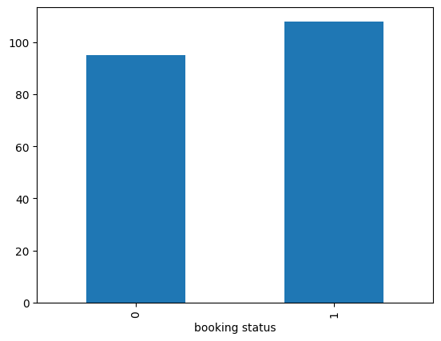
median price
Frankly the median price for the booking
is not a big deal

Slide 17
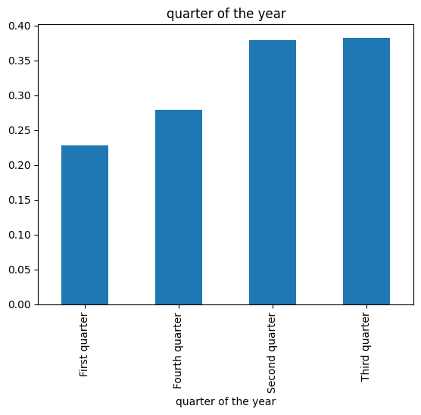
Here is the probability of cancelling the booking
at different periods of the year

Slide 18
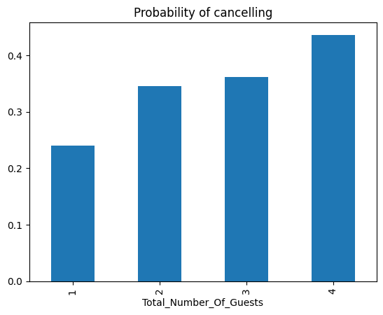
There is small positive correlation with
the total number of guests

Slide 19
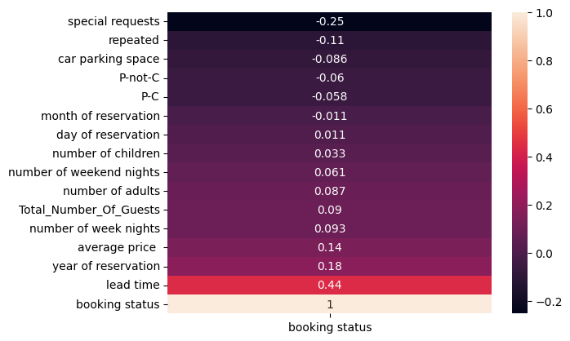
And here is a summary

